Slide 1

Green Pace
Security Policy Presentation
Developer: Brandon Hollada

Slide 2

OVERVIEW: DEFENSE IN DEPTH
The purpose of this security policy is to protect Green Pace systems and data with a well-defined security policy. With the daily increase in the number of ransomware, inside threats and vulnerable API’s a Defense-in-Depth method is needed. This will provide multiple layers of defense that utilize coding standards, Triple-A policies, appropriate risk analysis, and mitigation methods.

Slide 3
THREATS MATRIX
Likely STD-003-CPP (Improper string size) STD-005-CPP (Improper memory allocation) STD-008-CPP (Improper signal handling) | Priority STD-002-CPP (Uninitialized variables) STD-004-CPP (SQL Injection Risk) STD-009-CPP (Null pointer deference)
Low priority STD-006-CPP (Input-based assertions) STD-007-CPP (Unsafe exception handling) | Unlikely STD-001-CPP (Incompatible declarations) STD-010-CPP (Ignoring function errors)
The following table analyzes a selection of common coding standards and places them within it. The right side of the matrix means that the threat is a priority with the left being a low priority. The top of the matrix is likely to happen with the bottom being unlikely.

Slide 4
10 PRINCIPLES
Validate Input Data
Heed Compiler Warnings
Architect and Design for Security Policies
Keep It Simple
Default Deny
Adhere to the Principle of Least Privilege
Sanitize Data Sent to Other Systems
Practice Defense in Depth
Use Effective Quality Assurance Techniques
Adopt a Secure Coding Standard

Slide 5
CODING STANDARDS (Ordered by priority)
Prevent SQL injection – Apply input restrictions to prevent SQL injections
Uninitialized variables – Do not read uninitialized variables
Null pointer dereference – Do not access invalid memory
Check function errors – Preventable errors
Incompatible declarations – Do not create incompatible declarations of the same object
Buffer overflows – Guarantee storage for strings is sufficient
Memory protection – Ensure objects have sufficient memory
Signal Handling – Utilize volatile for signal handler variables
Assertions – Avoid input data for assertions
Avoid longjmp/setjmp – Do not use these

Slide 6
ENCRYPTION POLICIES
Encryption at rest:
This is the protection of data stored at physical locations.
Helps secure data even if the physical storage is compromised.
The policy is to ensure that physical data is encrypted in storage.
Access to physical locations is limited and monitored.
Encryption at flight:
This is the protection of data that is being transferred across a network.
This is to prevent packets of data from being grabbed in transit and used.
The policy for this would be for data transferring across a network to use encryption.
Encryption in use:
This is the protection of data that is being processed.
This is to prevent data from being used by a compromised system.
The policy for this would be to keep data isolated and contained to ensure only the necessary systems can utilize it.

Slide 7
TRIPLE-A POLICIES
Authentication:
This is the process of verifying the user's identity.
The policy to ensure this would be for the user to use a unique identifier such as a fingerprint, password, or multifactor authenticators.
Authorization:
This is the control that determines what the user has access to.
The policy for this would be to apply a least privileges policy. This policy means that users would only have access to the minimal resources that they need to complete their task.
Accounting:
This is the process of tracking activities of users within a system.
This is to assist with tracking down errors and vulnerabilities.
The policy for this would be to log identifiers of the users and system interactions. These logs would also need to limit access to prevent modifications.

Slide 8
Unit Testing
Unit testing should be robust and provide a variety of protection testing. The next few slides provide examples of what unit tests could be utilized.

Slide 9
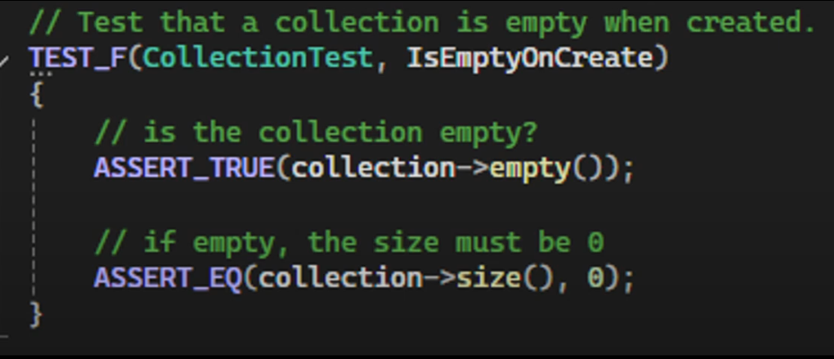
Unit Testing IsEmptyOnCreate

Slide 10
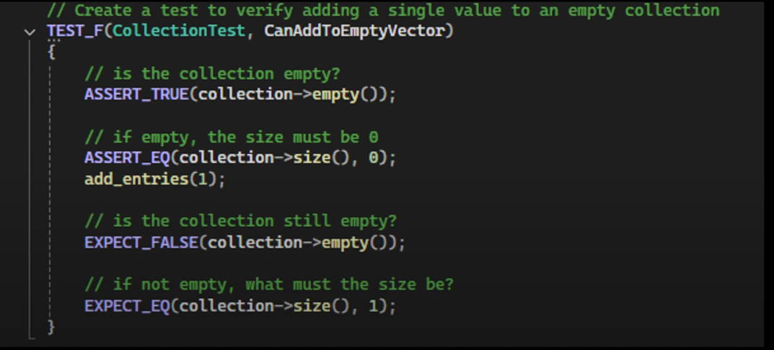
Unit Testing CanAddToEmptyVector

Slide 11
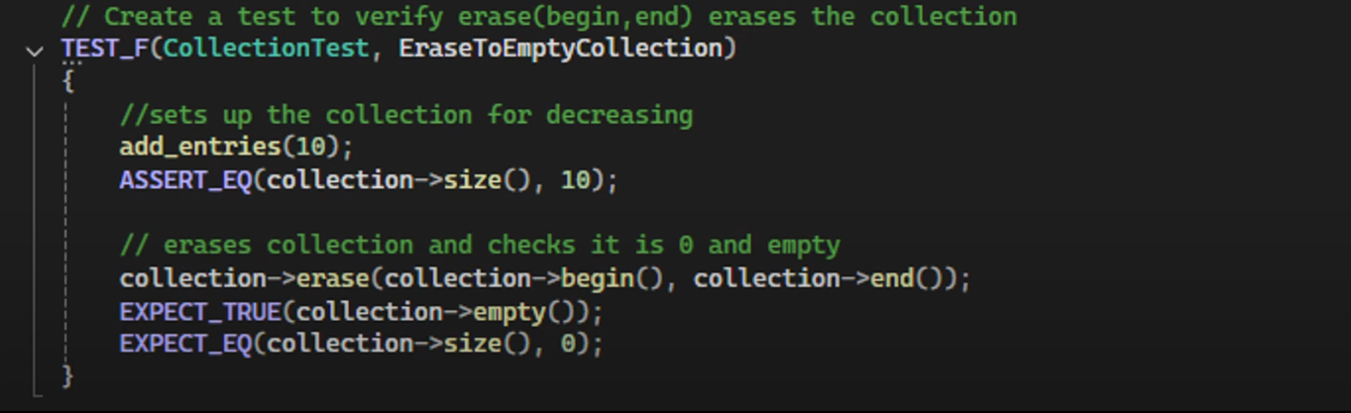
Unit Testing EraseToEmptyColection

Slide 12
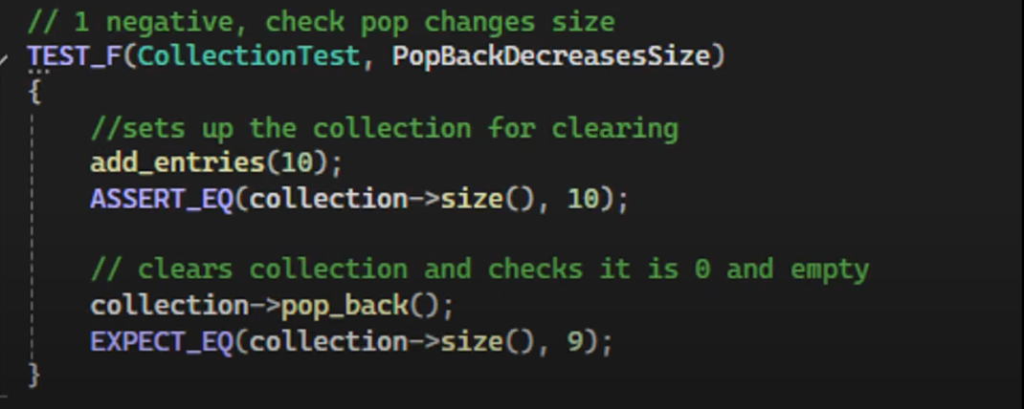
Unit Testing PopBackDecreasesSize

Slide 13

AUTOMATION SUMMARY

Slide 14
TOOLS
The DevSecOps pipeline is the integration of security into every phase of the DevOps lifecycle. This includes the stages of design to the deployment. This is to ensure that security is not an afterthought but implemented throughout development.
In the preproduction portion, tools such as plugins can be used to scan for vulnerabilities. These are to ensure that OWASP is met. In the build portions, static analysis tools like Cppcheck can be used to flag noncompliant builds. In the test portion, dynamic testing can be used to trigger security issues before production.
During the production stage, automated monitoring tools can be utilized to find suspicious activity. They will log the activity and allow for developers to track vulnerabilities. Tools can also be used to rollback changes and backup previous versions. In selecting the tools, it is important to have overlap in vulnerability protection and to ensure a wide coverage.

Slide 15
RISKS AND BENEFITS
Vulnerabilities in code occur when security is saved until the end. The policies above are suggestions and implementations that can help mitigate some of these risks. Allowing SQL injections can allow attackers to retrieve the data from entire databases. Ignoring input validations can allow for these attacks. Not protecting against overflows can allow for unintended behaviors or crashes. Not allocating the correct amount of data for objects and storage allows for this. The risks are clear and need addressed, which I feel this policy can provide the benefit of preventing these.
The area that this policy is lacking is that it does not address response and recovery mechanisms. These should be determined to assist in limiting the damages that a vulnerability causes.

Slide 16
RECOMMENDATIONS
Utilize this guide as a foundation for a policy.
Expanded standards and checks should be addressed with specific tools determined.
Have checks to ensure that policies are being followed.
Add a response section to address how vulnerabilities should be addressed.
Ensure that vulnerabilities are constantly re-evaluated.
Provide training on policies and tool usage.

Slide 17
CONCLUSIONS
Security should not be saved for the end as an afterthought.
This policy should not only be followed but expanded upon.
Once implemented, checks and testing should be constantly applied to ensure it is being followed effectively.
Defense-in-Depth should be applied across all systems. This means that each layer has overlapping protections.
Monitoring and documentation is key. Monitoring helps track vulnerabilities, and documentation ensures that they are understood and addressed.

Slide 18
REFERENCES
Seacord, R. C. (2013). Secure coding in C and C++ (2nd ed.). Pearson Technology Group.

